Slide 1
Day 3

Slide 2
Intel Offload Advisor

Slide 3
Agenda
Intel offload advisor - Purpose
Working of Intel offload advisor
Workflows available in offload advisor
How to generate offload advisor report
Offload modeling report overview

Slide 4
Intel Offload Advisor - Purpose
Find opportunities to offload/run your code on a target GPU
Identify potential performance hotspots on a target GPU
Measures performance of your application and compares it with its modeled performance on a selected target GPU so that you can decide what parts of your application you can execute on the GPU and how you can optimize it to get a better performance after offloading.

Slide 5
Intel Offload Advisor - Purpose (Contd.)
The Offload Modeling perspective can mainly help you in the following:
Determine if you should offload your code to a target device
Estimate potential speedup from running it on a different target
Identify loops recommended for offloading
Identify potential performance bottlenecks on the target device
Check how effectively data can be transferred between host and target devices.

Slide 6
Working of Offload Advisor
The Offload Modeling perspective runs the following steps:
Survey analysis - Get the baseline performance data for your application
CPU Utilization
Memory transfer and allocation
Data transfer patterns
Hotspots

Slide 7
Working of Offload Advisor
The Offload Modeling perspective runs the following steps:
2. Characterization analysis - Identify:
kernels invoked and executed
estimate cache and memory traffics on target device memory

Slide 8
Working of Offload Advisor
The Offload Modeling perspective runs the following steps:
3. Dependencies analysis - identify loop-carried dependencies that might block parallel execution

Slide 9
Working of Offload Advisor
The Offload Modeling perspective runs the following steps:
4. Performance Modeling - Estimate total program speedup on a target device and other performance metrics. Region is profitable if its execution time on the target is less than on a host.

Slide 10
Workflows in Offload Advisor
CPU-to-GPU offload modeling
profile an application running on a CPU and model its performance on a target GPU device to determine if you should offload parts of your application to the GPU
GPU-to-GPU offload modelling
profile an application running on a GPU and model its performance on a different GPU device to estimate a potential speedup from running your application on the different target

Slide 11
Run Offload Advisor
Set up the Intel Advisor environment variables
source /opt/intel/oneapi/setvars.sh
or
module avail | grep advisor
module load oneapi/advisor/2021.3.0
or
<installation using spack>

Slide 12
Run Offload Advisor
Installation using spack
Step 1 : spack installation
git clone https://github.com/spack/spack.git
cd spack
git checkout releases/v0.19
// locate setup-env.sh
// cd share/spack
// source setup-env.sh
source /home/cdacapp/Himanshu/spack/share/spack/setup-env.sh
spack --version

Slide 13
Run Offload Advisor
Installation using spack
Step 1 :install and load intel offload advisor
spack list advisor
spack install -v -j40 intel-oneapi-advisor
spack find intel-oneapi-advisor
spack load intel-oneapi-advisor
advisor

Slide 14
Run Offload Advisor
Run advisor command
advisor --collect=offload --config=gen11_icl --project-dir=./mmul_report -- ./mmult_serial

Slide 15
Run Offload Advisor
Run advisor command
advisor --collect=offload --config=gen11_icl --project-dir=./mmul_report – ./mmult_serial
Analyzes your application total execution time and execution time of its loops/functions using the Survey analysis
Counts how many iterations each cycle performs during application runtime using Characterization analysis
Estimates execution time for code regions that can be offloaded to a target GPU and total time to transfer data from CPU to target GPU using the Performance Modeling analysis

Slide 16
Run Offload Advisor
advisor --collect=offload --dry-run --config=gen11_icl --project-dir=./mmul_report -- ./mmult_serial
// it will run 3 internal commands
advisor --collect=survey --auto-finalize --static-instruction-mix --project-dir=./mmul_report -- ./mmult_serial
advisor --collect=tripcounts --flop --stacks --auto-finalize --cache-simulation=single --data-transfer=light --target-device=gen11_icl --project-dir=./mmul_report -- ./mmult_serial
advisor --collect=projection --no-assume-dependencies --config=gen11_icl --project-dir=./mmul_report -- ./mmult_serial

Slide 17
Run Offload Advisor (Cont)
Accuracy levels
--accuracy= Low/Medium/High

Slide 18
Run Offload Advisor (Contd…)
Accuracy levels
--accuracy= low/medium/high
Low Accuracy: This level requires minimal analysis, so the overhead is minimal (typically 5x to 10x slower than your original code). It focuses on basic execution time and floating-point operations, which are relatively quick to calculate
Medium Accuracy (default): This level adds more analysis, including cache simulation and estimates of data transfer between CPU and GPU. These simulations require additional processing power, leading to moderate overhead (typically 15x to 50x slower than your original code)
High Accuracy: This level performs the most extensive analysis, including detailed cache simulation, more refined data transfer estimates, and dependency analysis (for CPU applications). These complex simulations are computationally expensive, resulting in the highest overhead (typically 50x to 80x slower than your original code)

Slide 19
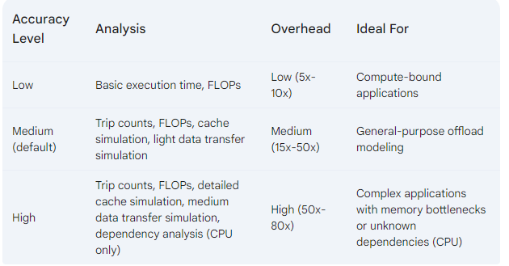
Run Offload Advisor (Cont)
Accuracy levels : --accuracy= Low/Medium/High
overhead refers to the additional processing time and resources required to perform the more detailed analyses

Slide 20
Run Offload Advisor (Cont)
Accuracy levels
--accuracy= Low/Medium/High
advisor --collect=offload –accuracy=medium --config=gen11_icl --project-dir=./mmul_report – ./mmult_serial

Slide 21
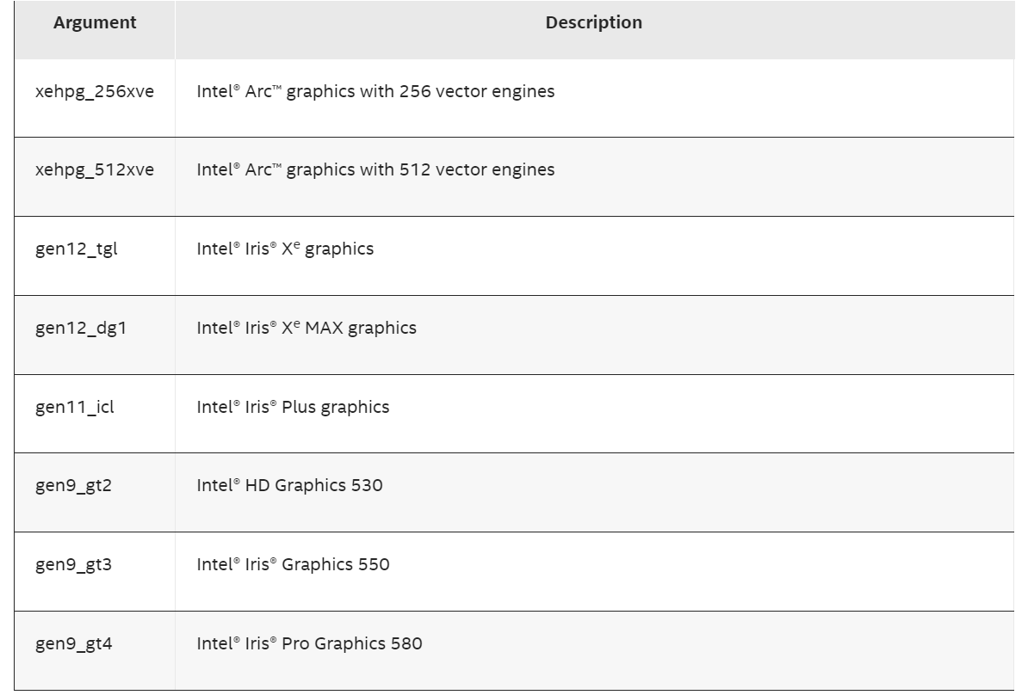
Run Offload Advisor (Cont)
Select target platform using --config
--config = <option>

Slide 22
Offload modeling report overview
Top Metrics & Program Metrics
performance estimations and comparison with the baseline application performance on CPU
Offload Bounded By
factors that limit the performance of regions in relation to their execution time
Top Offloaded
top regions recommended for offloading to the selected target device
Top Non-Offloaded
top regions not recommended to be run on the target device

Slide 23
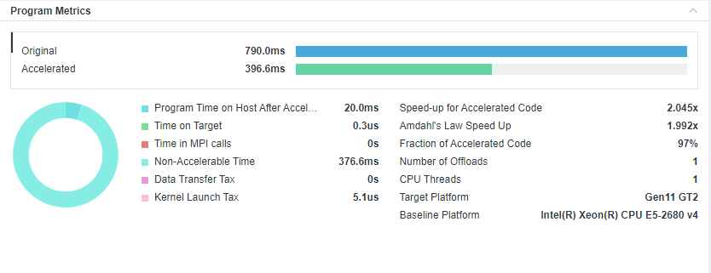
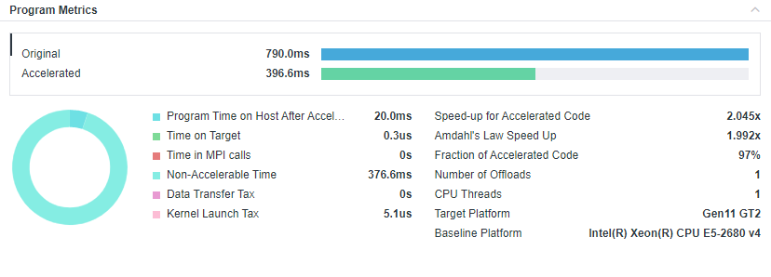
Intel advisor tells you…
How your code might perform on an accelerator?

Slide 24
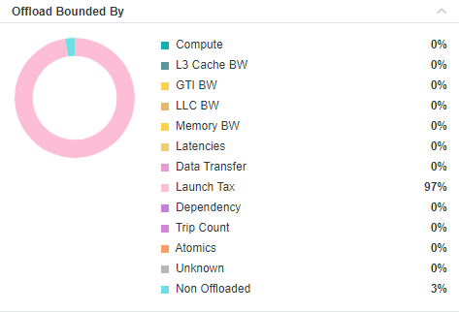
Intel advisor tells you…
What might be limiting your performance on the accelerator?

Slide 25
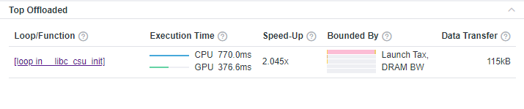
Intel advisor tells you…
What should you offload?

Slide 26
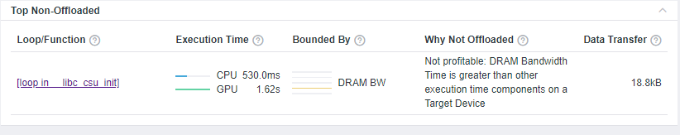
Intel advisor tells you…
What you should not offload and why?

Slide 27
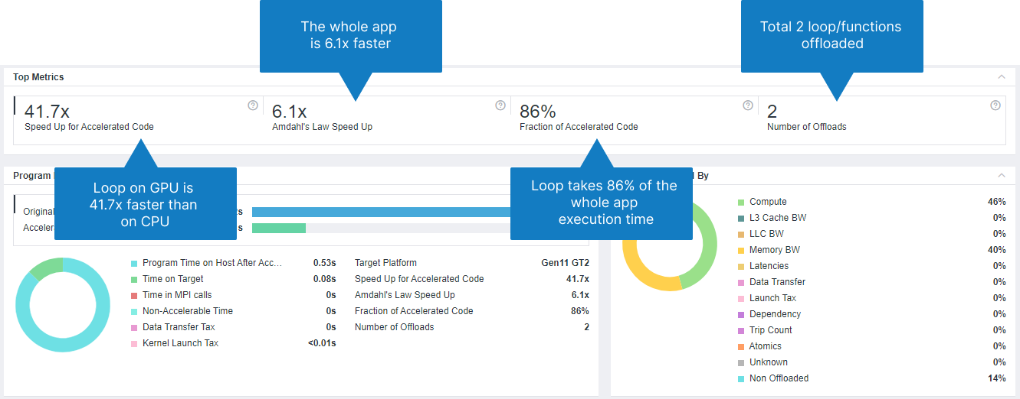

Slide 28
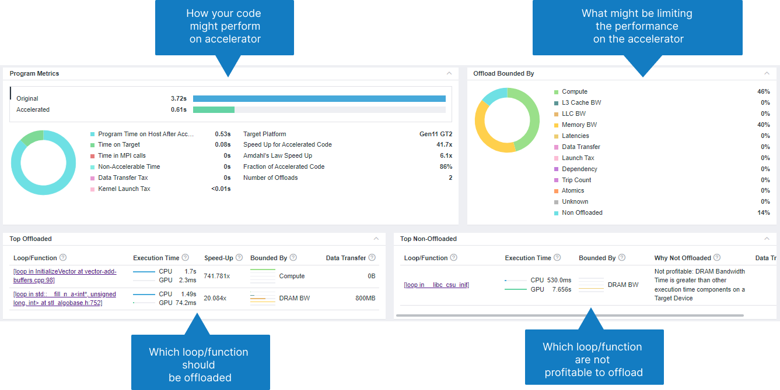

Slide 29
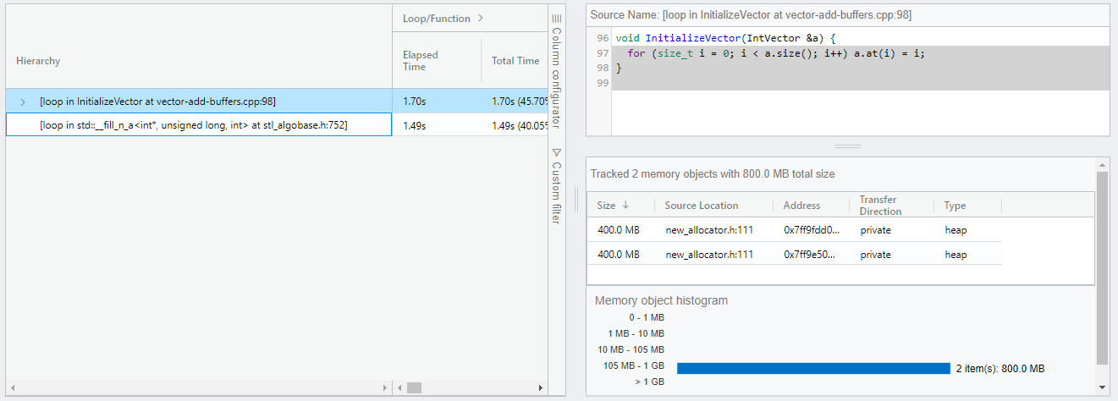
Top offloaded regions
Timings (total time, time on the accelerator, speedup)
Offload metrics (offload tax data transfers)
Memory traffic (DRAM, L3, L2, L1), trip count

Slide 30
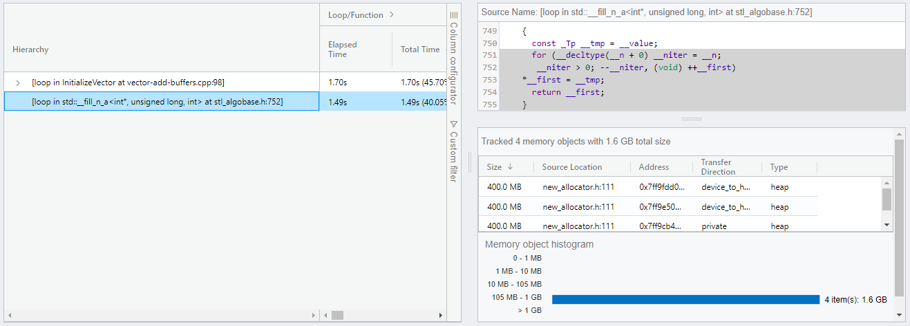
Top offloaded regions
Timings (total time, time on the accelerator, speedup)
Offload metrics (offload tax data transfers)
Memory traffic (DRAM, L3, L2, L1), trip count

Slide 31
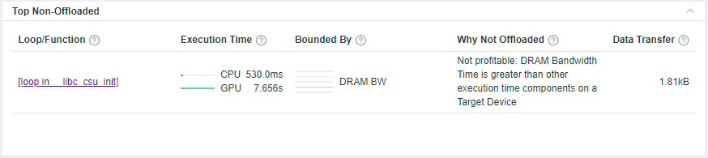
Top Non-offloaded Regions
Dependency issues
Not profitable/ less number of loops or iterations
Total execution time of function is too small

Slide 32
Summary of Offload Modeling
Measures performance of your application and compares it with its performance on a target GPU
Decide what parts of your application you can execute on the GPU
Main metrics for the modeled performance of application indicating if you should offload your application to a target device or not
Specific factors that prevent your code from achieving a better performance if executed on a target device (the factors that your code is bounded by)
Top offloaded loops/functions that provide the highest benefit and top non-offload loop/functions

